Slide 1
Introduction to Distributed System and Distributed Operating System

Slide 2
Basic concepts
The two dominating factors as important needs in the field of computing / information access
  The need for physically distributed hardware
    Distributed system
  The need for logically centralized software
    Distributed operating system

Slide 3
Distributed System
A distributed system is a collection of independent computers that appears to its users as a single coherent system – Andrew Tanenbaum
A distributed system is the one that prevents you from working because of the failure of a machine that you had never heard of – Veríssimo & Rodrigues
Weak definition: A distributed system is a collection of independent computers that are used jointly to perform a single task or to provide a single service.

Slide 4
Examples
Collection of Web Servers - more precisely, servers implementing the HTTP protocol—that jointly provide the distributed database of hypertext and multimedia documents that we know as the World-Wide Web
DNS servers
ATM networks etc.

Slide 5
Why Distributed System?
– Objectives of DS
Cost. Better price/performance as long as commodity hardware is used for the component computers.
Reliability. By having redundant components the impact of hardware and software faults on users can be reduced.
Inherent distribution. Naturally and physically distributed
Transparency. The end users can be concealed or hidden from the actual separation of the distributed system so that the user feels that everything is transparent to everyone.
Scalability. Resources such as processing and storage capacity can be increased significantly.
Dependability. The dependence of a system on another system can be achieved to solve a particular task jointly.
Performance. By using the combined processing and storage capacity of many nodes, performance levels can be reached that are beyond the range of centralized machines.
Flexibility. Easily can be added or removed a node

Slide 6
Transparency
Transparency is the hiding of the separation of the components of the distributed system from users and the application programmer.
Transparency means that any form of distributed system should hide its distributed nature from its users, appearing and functioning as a normal centralized system. There are many types of transparency:
    Access transparency – Regardless of how resource access and representation has to be performed on each individual computing entity, the users of a distributed system should always access resources in a single, uniform way.
    Location transparency – Users of a distributed system should not have to be aware of where a resource is physically located.
    Migration transparency – Users should not be aware of whether a resource or computing entity possesses the ability to move to a different physical or logical location.

Slide 7
    Relocation transparency – Should a resource move while in use, this should not be noticeable to the end user.
    Replication transparency – If a resource is replicated among several locations, it should appear to the user as a single resource.
    Concurrent transparency – While multiple users may compete for and share a single resource, this should not be apparent to any of them.
    Failure transparency – Always try to hide any failure and recovery of computing entities and resources.
    Persistence transparency – Whether a resource lies in volatile or permanent memory should make no difference to the user.

Slide 8
Why Challenges DS?
Very difficult to achieve because of the need of
  new component (network),
  Security
  and software complexity.
Also we assume that
  The network is reliable
  The network is secure
  Everything is homogenous
  The topology does not change
  Latency is zero
  Bandwidth is infinite
  Transport cost is zero
  There is one administrator
But these are not the cases in distributed system. This can be assumed in a non-distributed system. Hence there are challenges in DS.

Slide 9
Challenges in DS
Hence the different challenges that we repeatedly face in DS are to achieve the following things.
  Transparency
  Scalability
  Dependability
  Performance
  Flexibility

Slide 10
Transparency as a challange
Complete transparency is not always desirable due to the trade-offs with performance and scalability as well as the problems that can be caused while confusing local and remote operations.
Is not always possible because of natural limitations on how fast communication take place in WAN.

Slide 11
Scalibility as a challange
In a wide area distributed system, it is expected a large growth.
According to Neuman a system is said to be scalable if:
  It can handle the addition of users and resources without suffering a noticeable loss of performance or increase in administrative complexity.
But, this always does not happen because of the problems in followings.
  Size – growth in no of users and resources makes a distributed system overloaded - because it must process too many user requests
  Geography – increase in geography (distance between the nodes) generally results in greater communication delays and the potential for communication failure.
  Administration - As a distributed system grows, its various components (users, resources, nodes, networks, etc.) will start to cross administrative domains

Slide 12
Dependability as a challange
Although distributed systems provide the potential for higher availability due to replication, the distributed nature of services means that more components have to work properly for a single service to function.
But for dependability, all the systems should work jointly (dependent with each other) only when the data are fragmented and distributed.
In this situation, the dependability requires:
  Consistency
  Security
  Concurrency control and
  Fault tolerance
  Which are very difficult to achieve.

Slide 13
Performance as a challange
Any system should strive for maximum performance
But in the case of distributed systems this is a particularly interesting challenge, since it directly conflicts with some other desirable properties like
  Transparency
  Security
  Dependability
  Scalability
  can easily be detrimental to performance.

Slide 14
Flexibility as a Challenge
A flexible distributed system can be configured to provide exactly the services that a user or programmer needs.
But for that kind of flexibility a system should have the number of key properties.
  Extensibility
  Openness
  Interoperability
  Which is very difficult to achieve because it contradicts with the other desirable properties as well

Slide 15
True Distributed System
A distributed system with all the challenges like transparency, scalability, Dependability, Performance, and Flexibility, being solved to its full extent, is called a True Distributed System (TDS).
However, because of the different problems (like a need of new component (network), security and software complexity faced during the development of a distributed system, a TDS is virtually possible.

Slide 16
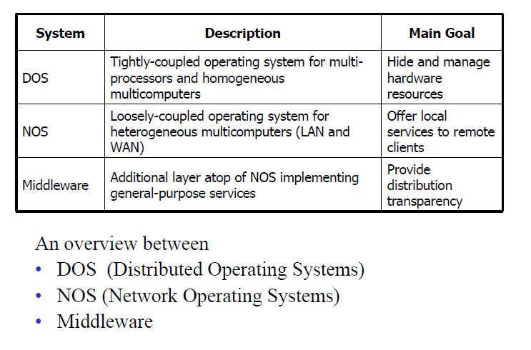
Software Concept in Distributed System

Slide 17
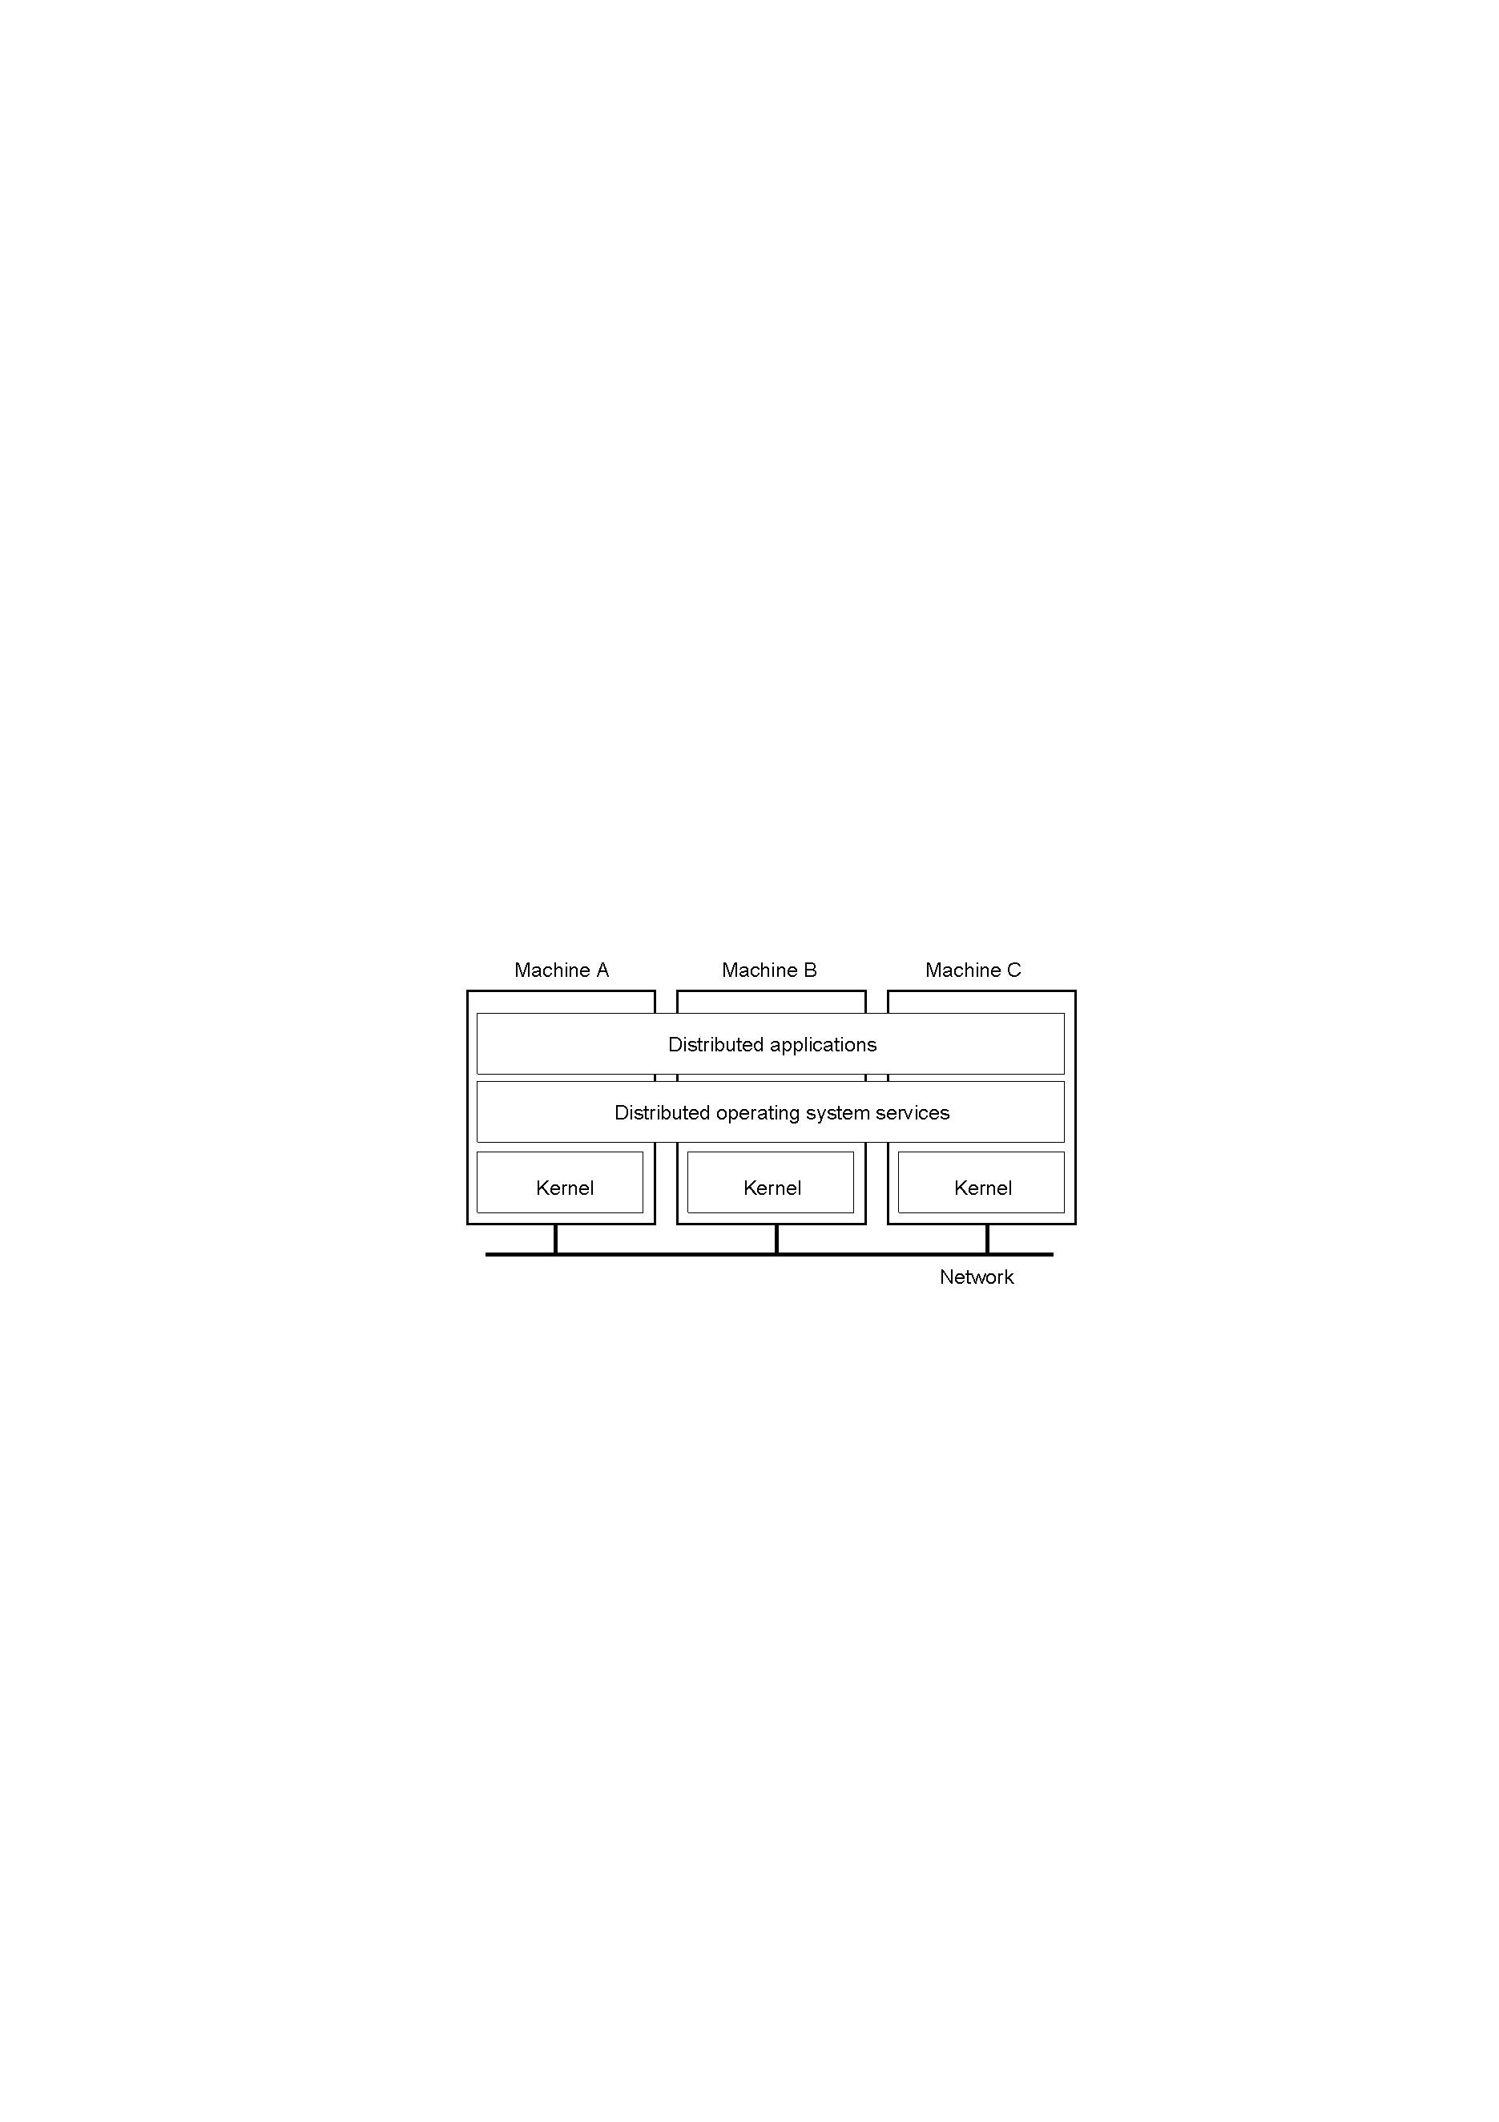
Distributed Operating System (1)
Tightly-coupled operating system for multi-processors and homogeneous multi-computers. Strong transparency.

Slide 18
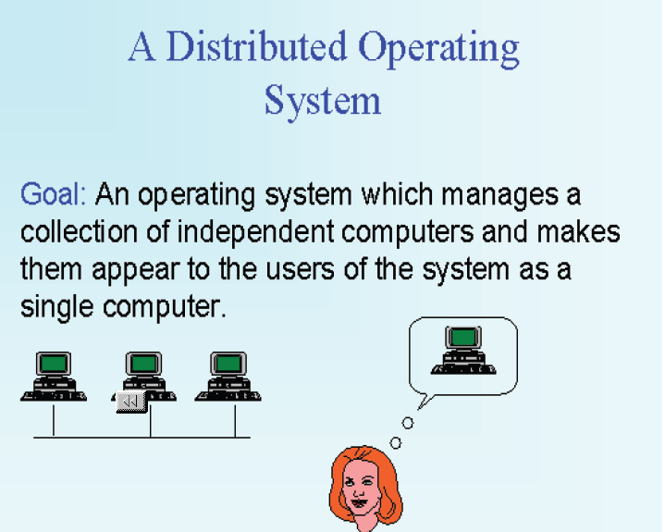
Distributed Operating System (2)

Slide 19
Distributed Operating System (3)
A distributed operating system is the logical aggregation of operating system software over a collection of independent, networked, communicating, and physically separate computational nodes (a distributed system)
Individual nodes each hold a specific software subset of the global aggregate operating system.
Each subset is a composite of two distinct service provisioners.
  Kernel - that directly controls that node’s hardware.
  System management components - that coordinate the node's individual and collaborative activities. These components abstract microkernel functions and support user applications.
The collection of kernel and system management components work together to make the distributed systems to appear as a single system image.

Slide 20
DOS: characteristics (1)
Distributed Operating Systems
  Allows a multiprocessor or multicomputer network resources to be integrated as a single system image
  Hide and manage hardware and software resources
  provides transparency support
  provide heterogeneity support
  control network in most effective way
  consists of low level commands + local operating systems + distributed features
  Inter-process communication (IPC)

Slide 21
DOS: characteristics (2)
remote file and device access
global addressing and naming
trading and naming services
synchronization and deadlock avoidance
resource allocation and protection
global resource sharing
deadlock avoidance
communication security
no examples in general use but many research systems: Amoeba, Chorus etc. see Google “distributed systems research”

